Slide 1
Summary of Learning
Press Sound Button for Presentation on the Slides! →
Paige Belcourt

Slide 2
Main Takeaways
Online Presence
Digital Identity
Digital Citizenship
Digital Literacy
Digital Teaching
SAMR Model
Online Resources
Digital Tools
AI
Ad Blockers

Slide 3
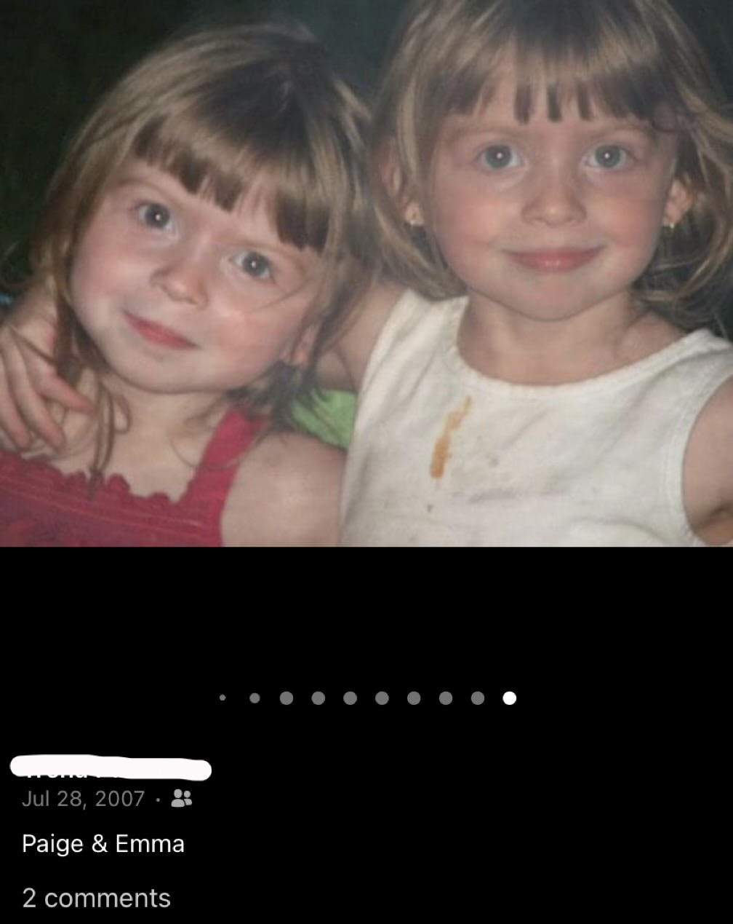
Online Presence – Digital Identity
Lasts forever
Will replace resumés in the future
Age of Participation
Screen Time!

Slide 4
Online Presence – Digital Citizenship
Last forever
Will replace resumés in the future
Be kind, be responsible
Ribbles Nine Elements
Vigilantism
THIS IS DIFFICULT!

Slide 5
Online Presence – Digital Literacy
Understanding misinformation and disinformation
Checking your sources
Checking biases
Algorithms – Vacuum
Http vs. Https

Slide 6
tech Teaching
SAMR Model
Substitution, Augmentation, Modification, Redefinition
Online Resources
Teaching tech
Scare tactics don’t work
Answer questions, Inform Students, Monitor Safety (AIM)

Slide 7
Digital Tools
Tools for Teachers
AdBlockers
Zoom
Online Classrooms
Tools for Both
PowerPoint
OneTab
JamBoard
Tools for Students
iMovie
Canva
Scratch/Hour of Code

